Slide 1


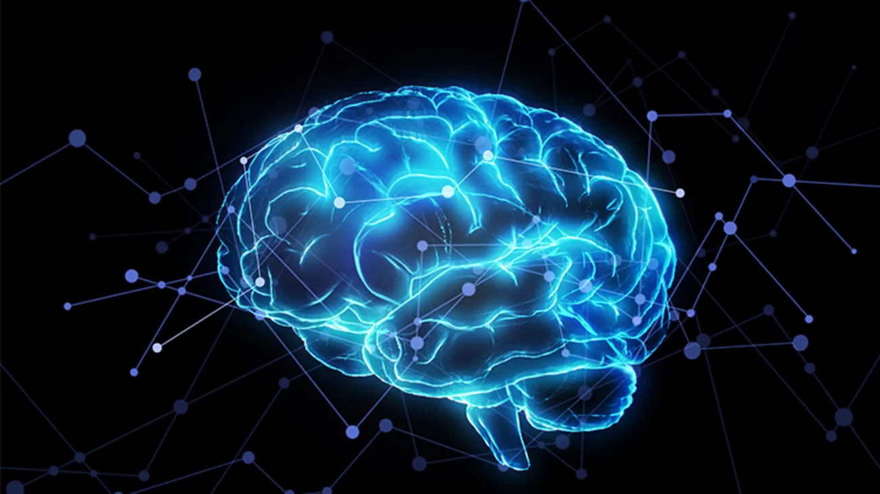

Machine learning in neuroscience
Notes:
Hi Everyone,
My name is Iona. I am one of your TAs for the machine learning in neuroscience module. We decided to provide you with some very short videos about the module and python programming. At the end of some of the videos there will be a 'challenge yourself' to see what you have learnt. This video aims to show you some of the use cases and motivate you to explore machine learning as a tool for neuroscience research.

Slide 2




Python
General-purpose, high-level, interpretable programming language
Open source
Simple, easy to learn syntax
Readable
Invented by Guido van Rossum
Popular uses: data science, machine learning, AI
Notes:
The language we will be using in this module is Python. Python is a general-purpose, high-level, interpretable programming language.
It is opensource and has an easy to learn syntax. It was invented by Guido van Rossum.
Python has many popular uses, such as data science, machine learning and AI.

Slide 3
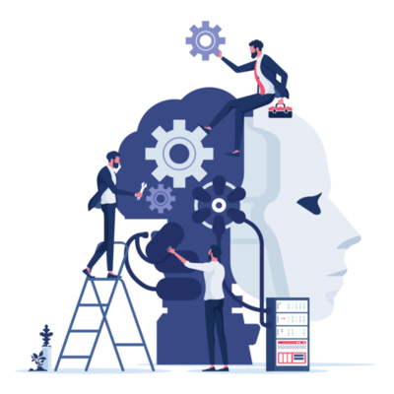
Machine learning in neuroscience
Disease classification
Brain activity decoding
Personalised medicine
Mapping the brain connectome
Predicting disease outcome
Functional connectivity analysis
Notes:
Machine learning accelerates neuroscience by uncovering complex patterns in brain data, enabling novel insights into brain function, disease mechanisms, and therapeutic strategies. The research areas range from disease classification to mapping the brain connectome. Machine learning enables us to utilise the full potential of data to make data driven discoveries.

Slide 4

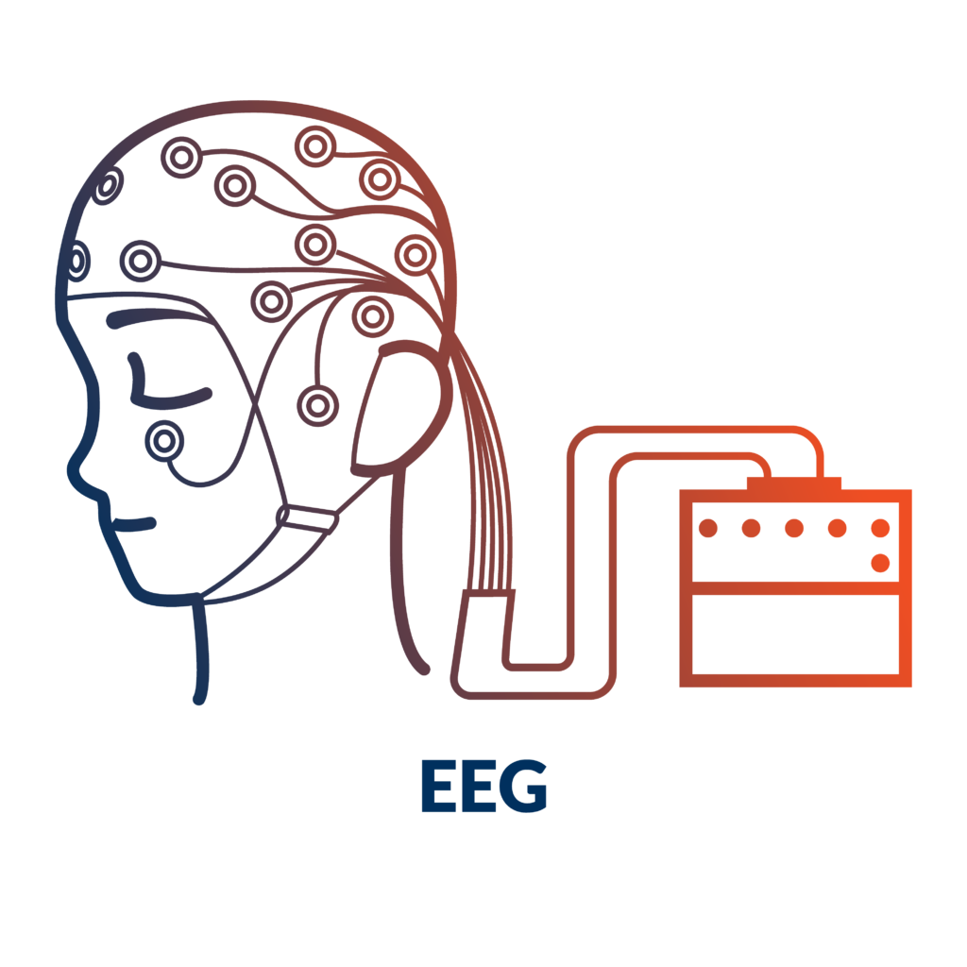


Example data types
MRI
EEG
Electronic health record data
Genomic data
Notes:
There are many diferent types of data that can be used in machine learning for neuroscience, such as imaging data, genomic data or electronic health record data. Data comes in many different forms, such as structured numerical data, or unstructured text. Based on the data type and format, the appropriate research techniques may differ.

Slide 5
Challenges in machine learning for neuroscience
Limited data availability
Interpretability of models
High-dimensional data and overfitting
Ethical considerations and bias in machine learning models
Notes:
Even though machine learning provides a novel approach to conducting research, there are still challneges.
Many neuroscience datasets are small, making it challenging to train machine learning models effectively without overfitting.
Machine learning models, especially deep learning, often act as "black boxes," making it difficult to interpret their findings in a biologically meaningful way.
High dimensional data can result in overfitting
Privacy concerns and ethical challenges arise when using sensitive patient data for training models.

Slide 6

The team!
Notes:
And that brings us to the end of the first video. You will learn a lot more about the previously mentioned points in the lecture series. We look forward to meeting you all in the module!

